Slide 1



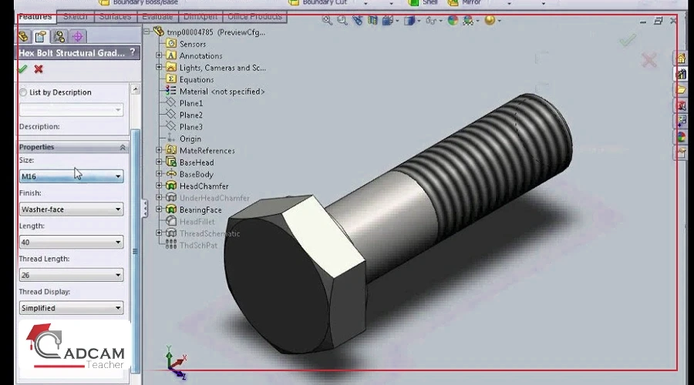
TEAM : SOLID
Solidworks
AI Hackathon
Members: Priyansh Keshari, Hemant Sharma
Institution: Indian Institute of Technology
(Indian School of Mines), Dhanbad
Dassault Systèmes

Slide 2

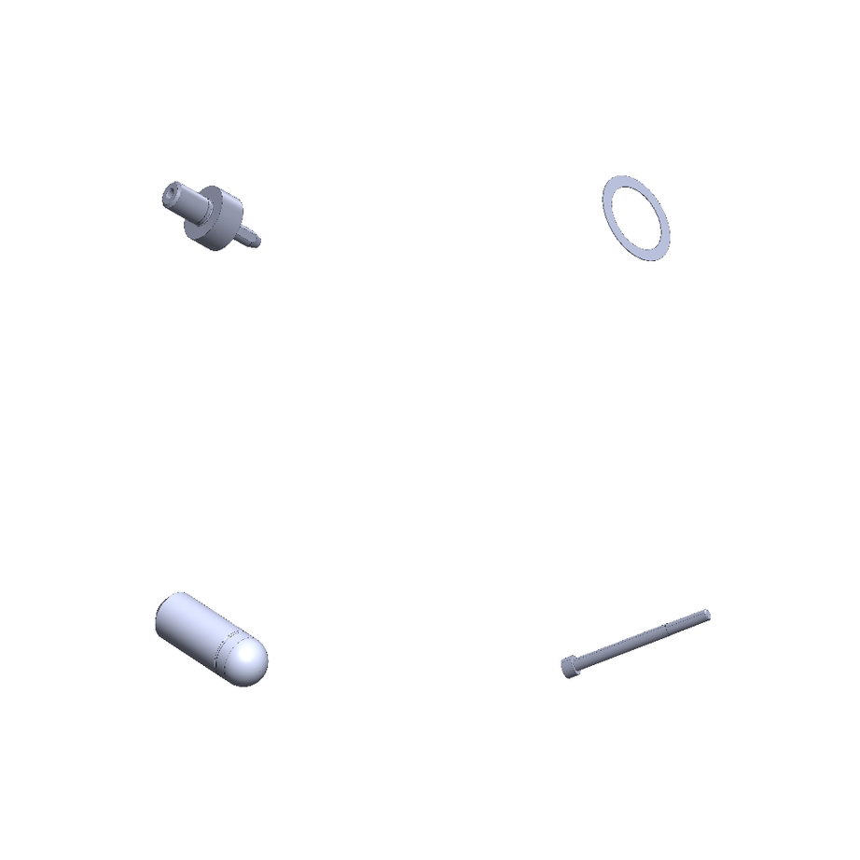

02
TEAM : SOLID
Overview
In industrial automation and inventory management, precision is non-negotiable. This project addresses the challenge of counting mechanical parts—specifically Bolts, Nuts, Washers, and Locating Pins—from synthetic CAD-rendered images.
The core difficulty lay in the Exact-Match Accuracy metric: an image is considered correct only if the predicted count for every single part type matches the ground truth exactly. A single error (e.g., missing one faint washer in a scene of 10 objects) results in a score of 0 for that entire image.

Slide 3


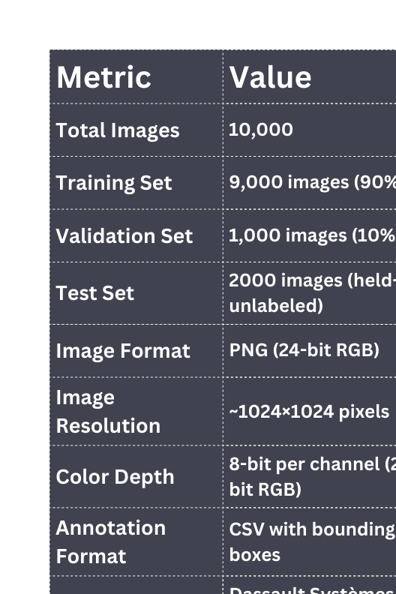
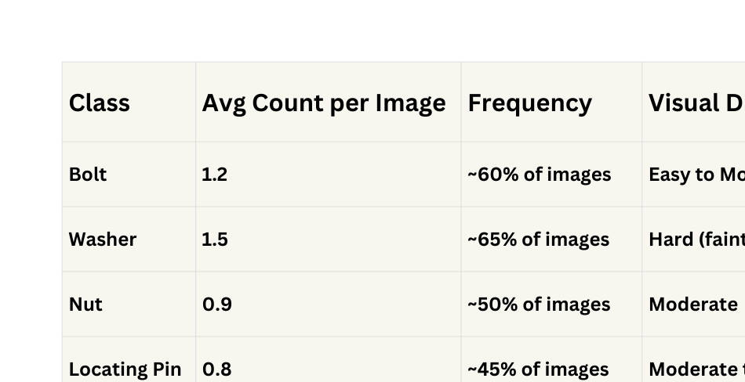
03
TEAM : SOLID
Dataset
Key Observation: Washers appear most frequently but are hardest to detect due to low visual contrast.

Slide 4
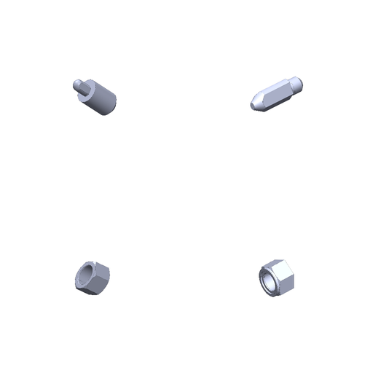
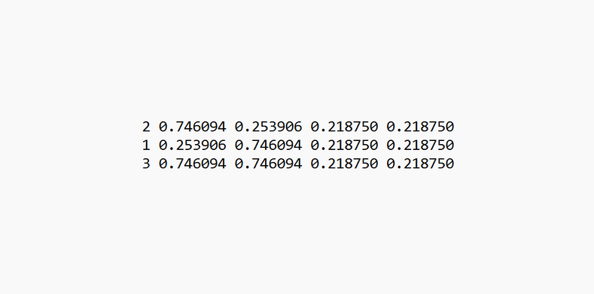

Methodology
04
TEAM : SOLID
Data Collection
Preprocessing
Model Selection
• Synthetic Dataset: 10,000 CAD-rendered images (SOLIDWORKS)
• Clean White Background: Consistent lighting and rendering
• 4 Part Classes: Bolt, Nut, Washer, Locating Pin
• Bounding Box Annotations: (x, y, width, height) format
• High Resolution: ~1024×1024 pixels per image
• Resizing: Normalized to 640×640 for YOLO inference
• Augmentation: Mosaic (4-in-1 stitching) to simulate density
• Aggregated multiple row-wise annotations per image into single YOLO-format text files containing class IDs and bounding-box coordinates for all object instances.
• Backbone: YOLOv8s (Small) - fast convergence from scratch
• Architecture: CNN-based object detector with anchor-free design
• Training: 150 epochs, AdamW optimizer, batch size 64
• Inference: Parallel predictions across 3 TTA views
• Ensemble Method: Median voting for robust count aggregation

Slide 5



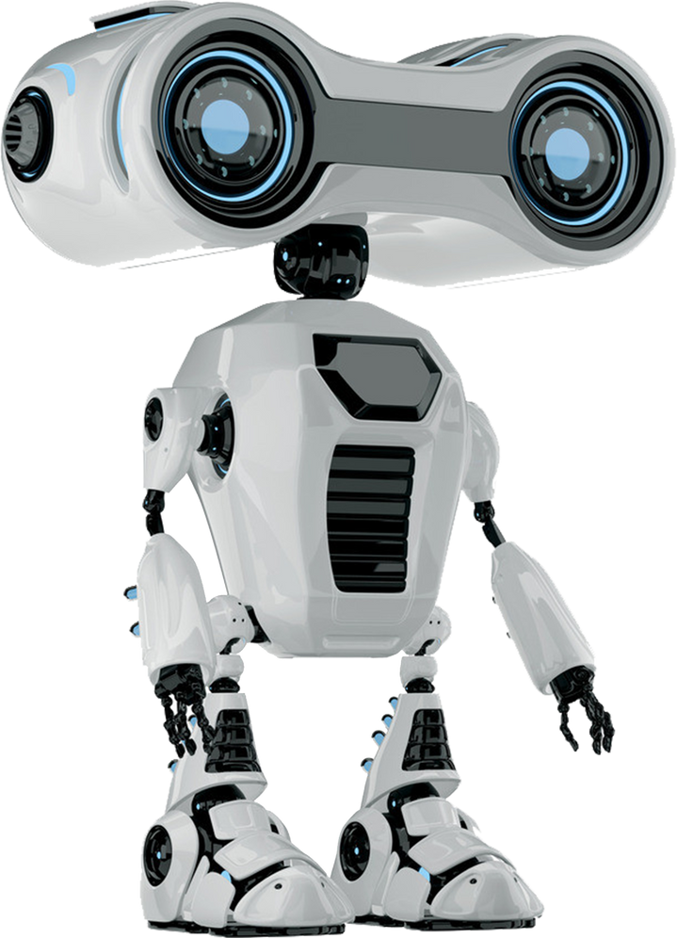
Model Development
& Training
05
TEAM : SOLID
Training Configuration
Hyperparameters
• Architecture: YOLOv8s (Small)
• Pre-training: False
• Input Resolution: 1024×1024
• Imgsz: 640
• Batch Size: 64
• Epochs: 150 (early stop at 120)
• Optimizer: AdamW (momentum 0.937)
• Learning Rate: 0.01 (cosine schedule)
• IoU Threshold: 0.60
• Weight Decay: 0.0005
• Warmup Epochs: 3
• Validation Split: 10% of training
• Mosaic: 1.0
• Patience: 30
Data Processing Pipeline:
Label CSV → Aggregate by image_name → Generate YOLO format (.txt) → Train/Val split → YOLOv8 training loop

Slide 6


Approach
06
TEAM : SOLID
Test-Time Augmentation (TTA)
Median Voting Aggregation
Adaptive Confidence Thresholds
• Technique: Run inference on 3 views:
1) Original image
2) Horizontal flip
3) Vertical flip
• Benefit: Detects objects missed in one view but visible in another
• Process: Take median count across 3 TTA views
Predictions → Median
• Advantage: Filters outliers while preserving consensus (better than mean or max)
Example :
Median([4, 3, 4]) = 4 ✓ (Correct)
Mean([4, 3, 4]) = 3.67 X (Wrong)
Large Parts (Bolts): Higher threshold (0.50) to avoid false positives
Medium Parts (Locating Pins, Nuts): Medium threshold (0.35) for balance
Small Parts (Washers): Lower threshold (0.15) to prevent missing occluded objects

Slide 7

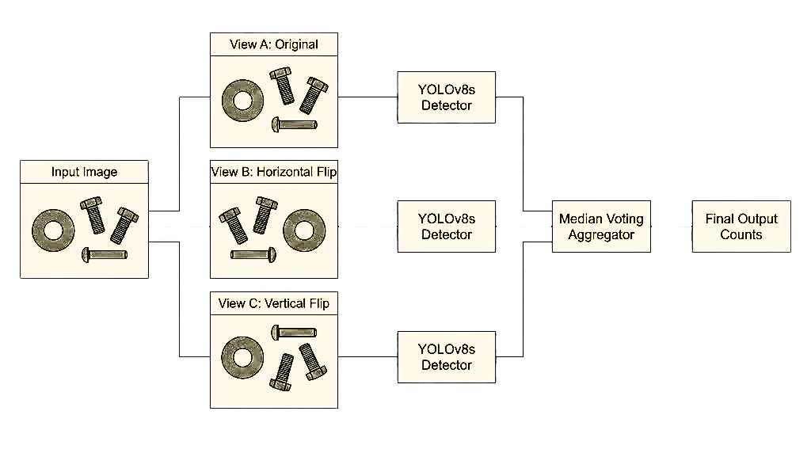
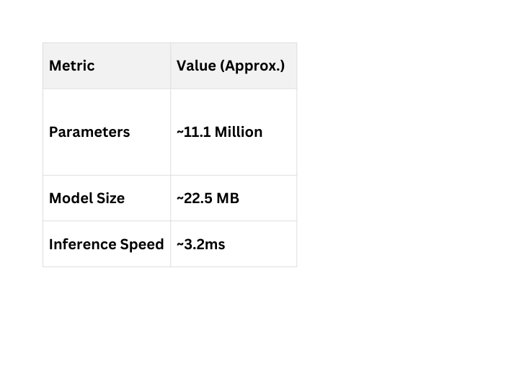
Model Architecture
07
TEAM : SOLID
YOLO Version 8 Small

Slide 8
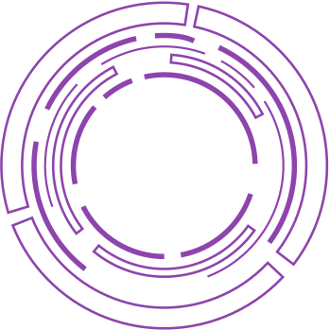
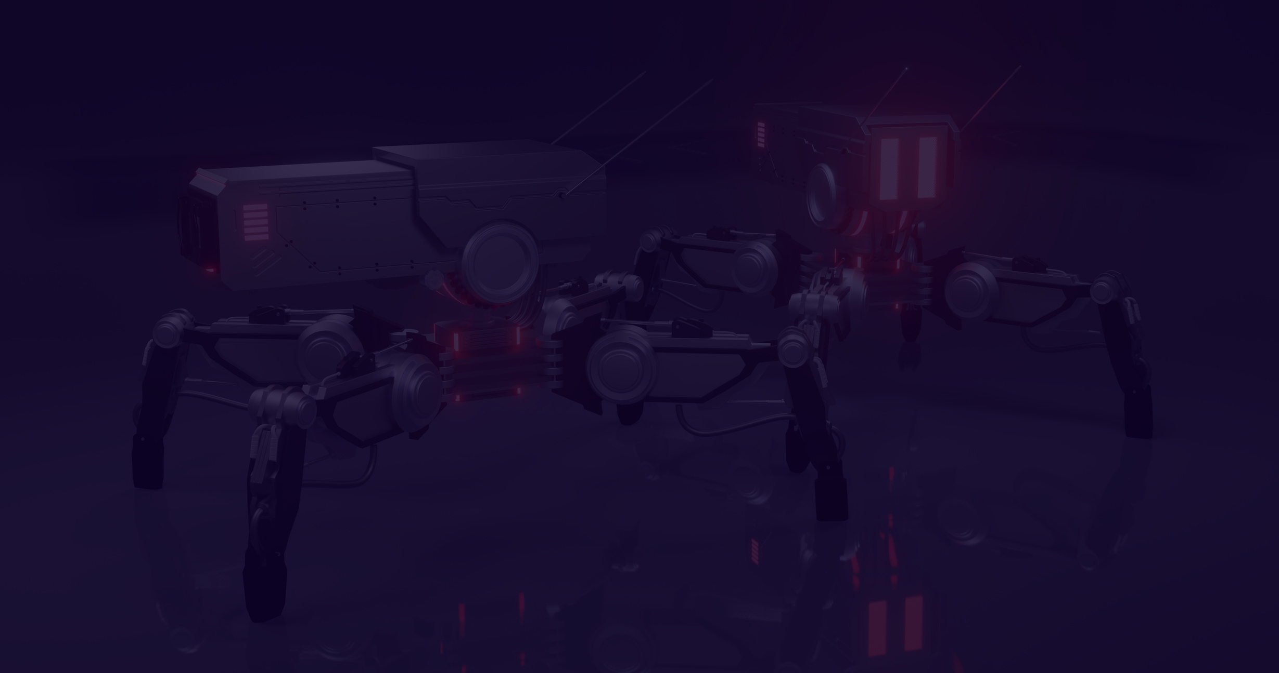


Architecture Comparison
08
TEAM : SOLID
ResNet Regression
Score : 0.9750
ResNet Multi-Head Classification
Score : 0.9921
Image → ResNet50 → FC(4) → [bolt,nut,pin,washer]
Image → ResNet50 → 4xFC → 4xArgmax
X
No localization
Issue : Pre-Trained on ImageNet
!
Overlap issues
Issue : Pre-Trained on ImageNet
YOLOv8m Base
Score : 0.9986
YOLOv8m + TTA
Score : 0.9929
Image → YOLOv8m → Boxes → Count
Image → YOLOv8m → TTA → Count
Breakthrough
Issue : Pre-Trained on COCO
Breakthrough
Issue : Pre-Trained on COCO
YOLOv8m + TTA + Median
Score : 1.0000
YOLOv8s + TTA + Median
Score : 1.0000
Image → YOLOv8m → TTA → Count
Image → YOLOv8s → TTA → Count
Perfect Score
Issue : Pre-Trained on COCO
Perfect Score
Best Trained from Scratch

Slide 9



Evaluation Metrics - (1)
TEAM : SOLID
1. Primary Metric: Exact-Match Accuracy
• Expression :
Score = (1/N) × Σ 𝟙(C_pred[i] = C_true[i])
Where :
N is the total number of test images.
C_pred[i] predicted count vector for the i-th image
C_true[i] ground truth count for the i-th image.
𝟙 indicator function, which equals 1 if the condition inside is true, and 0 otherwise.
• All 4 class counts must match exactly (Bolt, Nut, Washer, Pin)
• One error = Image score = 0 (no partial credit)
09
Continued......

Slide 10
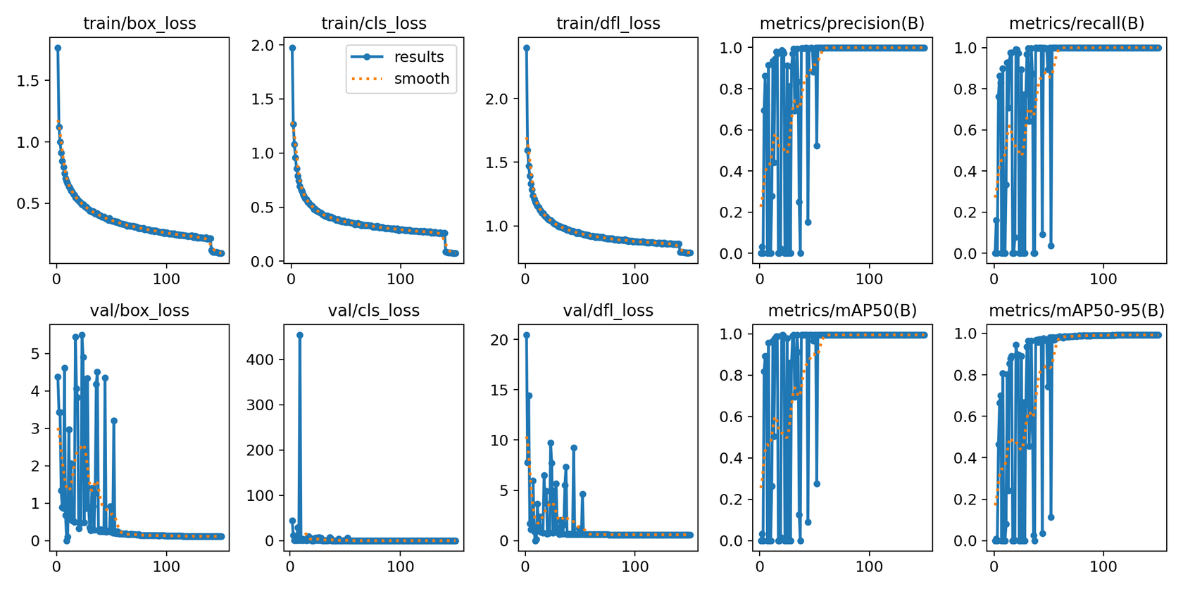
Evaluation Metrics - (2)
TEAM : SOLID
2. Validation Setup
• Split Ratio: 90% Training / 10% Validation (stratified)
• Purpose: Tune confidence thresholds & detect overfitting without touching test set
10
final

Slide 11


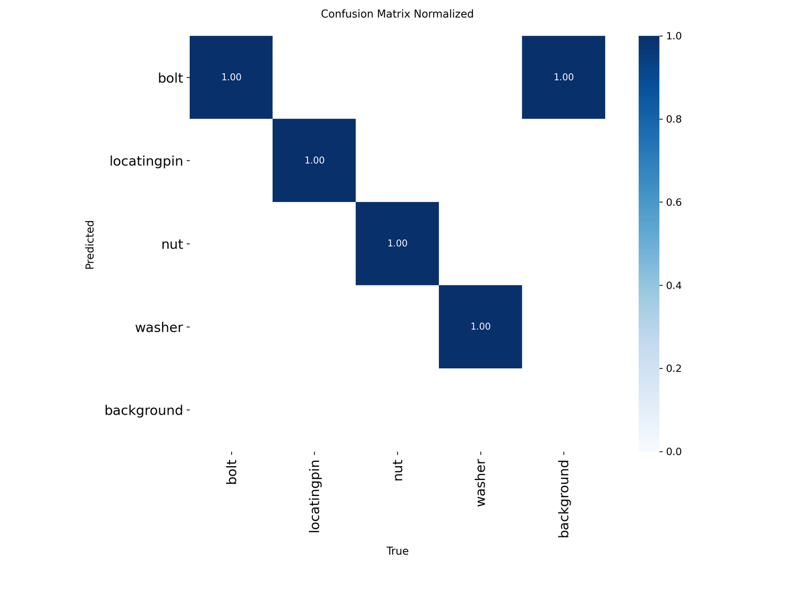
Result & Reliable
11
TEAM : SOLID
The Reliability Engine: 3 Steps to Perfection
1. Precise Discrimination (YOLOv8s): Achieves a 1.00 confusion matrix diagonal by learning distinct features for every part type (Bolt ≠ Nut ≠ Washer ≠ Locating Pin), ensuring zero misclassification through explicit localization.
2. Maximum Coverage (TTA): A 3-view ensemble (Original + Horizontal + Vertical Flips) exposes occluded parts from different angles, ensuring 100% recall by spotting objects hidden in standard views.
3. Robust Filtering (Median Voting): A mathematical safety net that requires only a 2/3 consensus to validate a count. This automatically rejects outlier predictions from any single bad view, guaranteeing exact-match accuracy.

Slide 12

Why the solution is scalable?
TEAM : SOLID
Modular Architecture
Flexible Deployment
• Dataset Prep: Independent pipeline—handles 10K or 10M images without code changes
• Training Engine: Separate module—swap YOLOv8s → YOLOv8s/n/x instantly via config
• Inference Logic: Decoupled TTA + Median Voting acts as plug-and-play microservice
• Model Scaling: YOLOv8 family spans Nano (edge) → Extra Large (cloud) seamlessly
• Hardware Independent: Parallelizable across single GPU to multi-node clusters
• Tunable Accuracy-Speed: TTA can use 1, 3, or 5+ views based on latency budget
12

Slide 13



TEAM : SOLID
Thank You!
Get in touch with us
github.com/priyanshkeshari/SOLIDWORKS-AI-Hackathon

